Slide 1
Agenda 15 April 2021 - CMS
Dissemination strategy – ideas from CPMS
Our logo - Livia
Analyze feedback from the survey
Somalia – Ben
Mozambique - Filipa
AOB
Feedback on Disability feedback from CBM Global, IRC – Agnes
HNPW – 21 April
Brainstorm Retreat Session
Notes:
21 to 25 June 2021
1

Slide 2
Tips from CPMS
Background on how you developed the Standards
Online interactive platform
Promotion on social media
Use existing partnerships
Email templates WG members to send to their existing networks
Multilanguage
Different events to capture different audiences (donors, cluster coordinators, practitioners)
Ted talk videos
Case study use
“order your copy now”
Notes:
Anyone want to start working on this for July?, What do we do with our FAQ?
2

Slide 3
Workplan 2021
Notes:
3

Slide 4
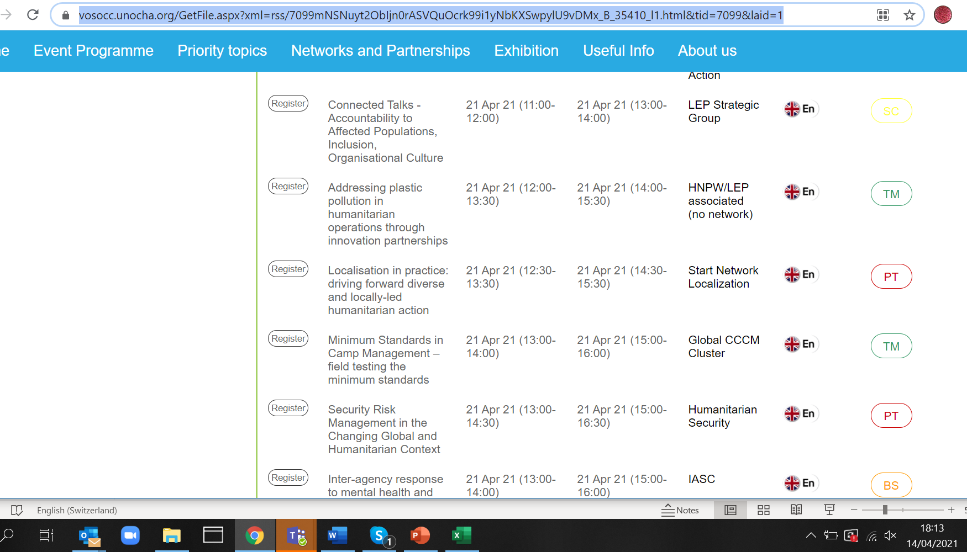
HNPW!
https://vosocc.unocha.org/GetFile.aspx?xml=rss/7099mNSNuyt2ObIjn0rASVQuOcrk99i1yNbKXSwpylU9vDMx_B_35410_l1.html&tid=7099&laid=1
Notes:
4

Slide 5
