Slide 1
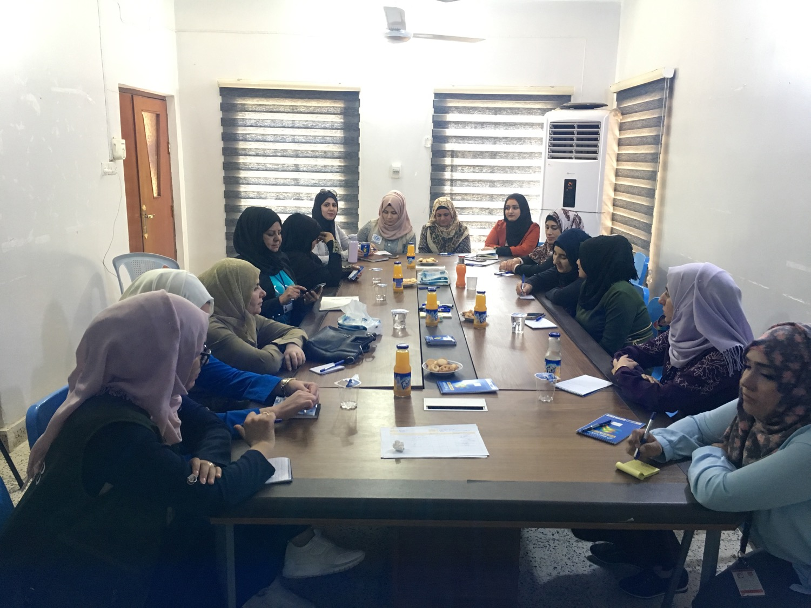



Women’s Participation Research:
The Role of Displaced Women in Coordination
Anna Hirsch-Holland, November 2019

Slide 2
Project background
2016 - 2017
2016 – 2018
Roll-out of the Toolkit (IOM, WRC, NRC)
2019
Research on women’s participation and safety in camps (NRC)
Development of Women’s Participation Toolkit (IOM and Women’s Refugee Commission)

Slide 3





Research objectives
What do women contribute to coordination? What are the barriers and enablers for their participation in it?
How can CM agencies enhance women’s participation in and influence through coordination?
How can women’s improved role in coordination address the safety and protection of women and girls?

Slide 4
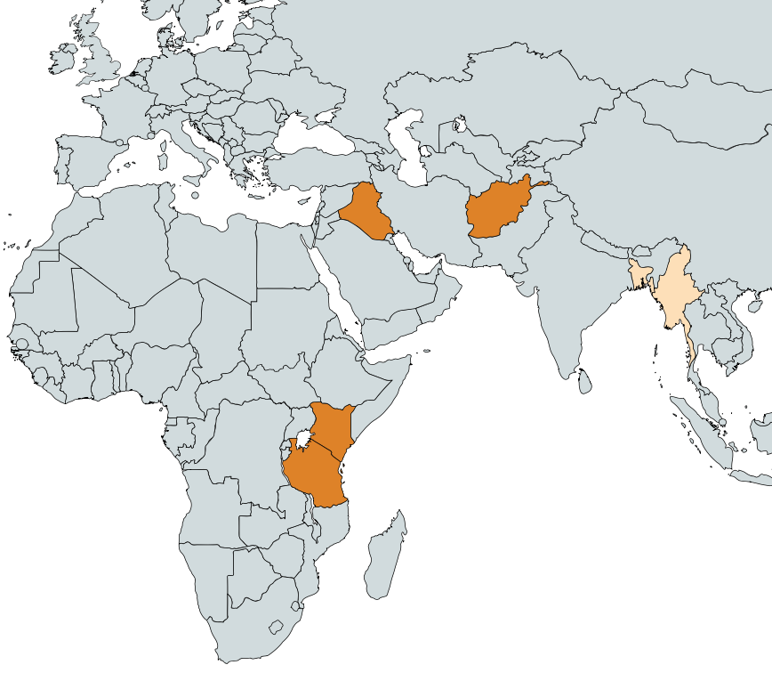

Research activities
Desk review
Field work (Iraq, Afghanistan, Kenya, Tanzania)
Interviews with CM staff (Myanmar, Bangladesh)
Notes:
In Tanzania, field work was restricted since the researcher could not obtain an entry permit to the camp.

Slide 5
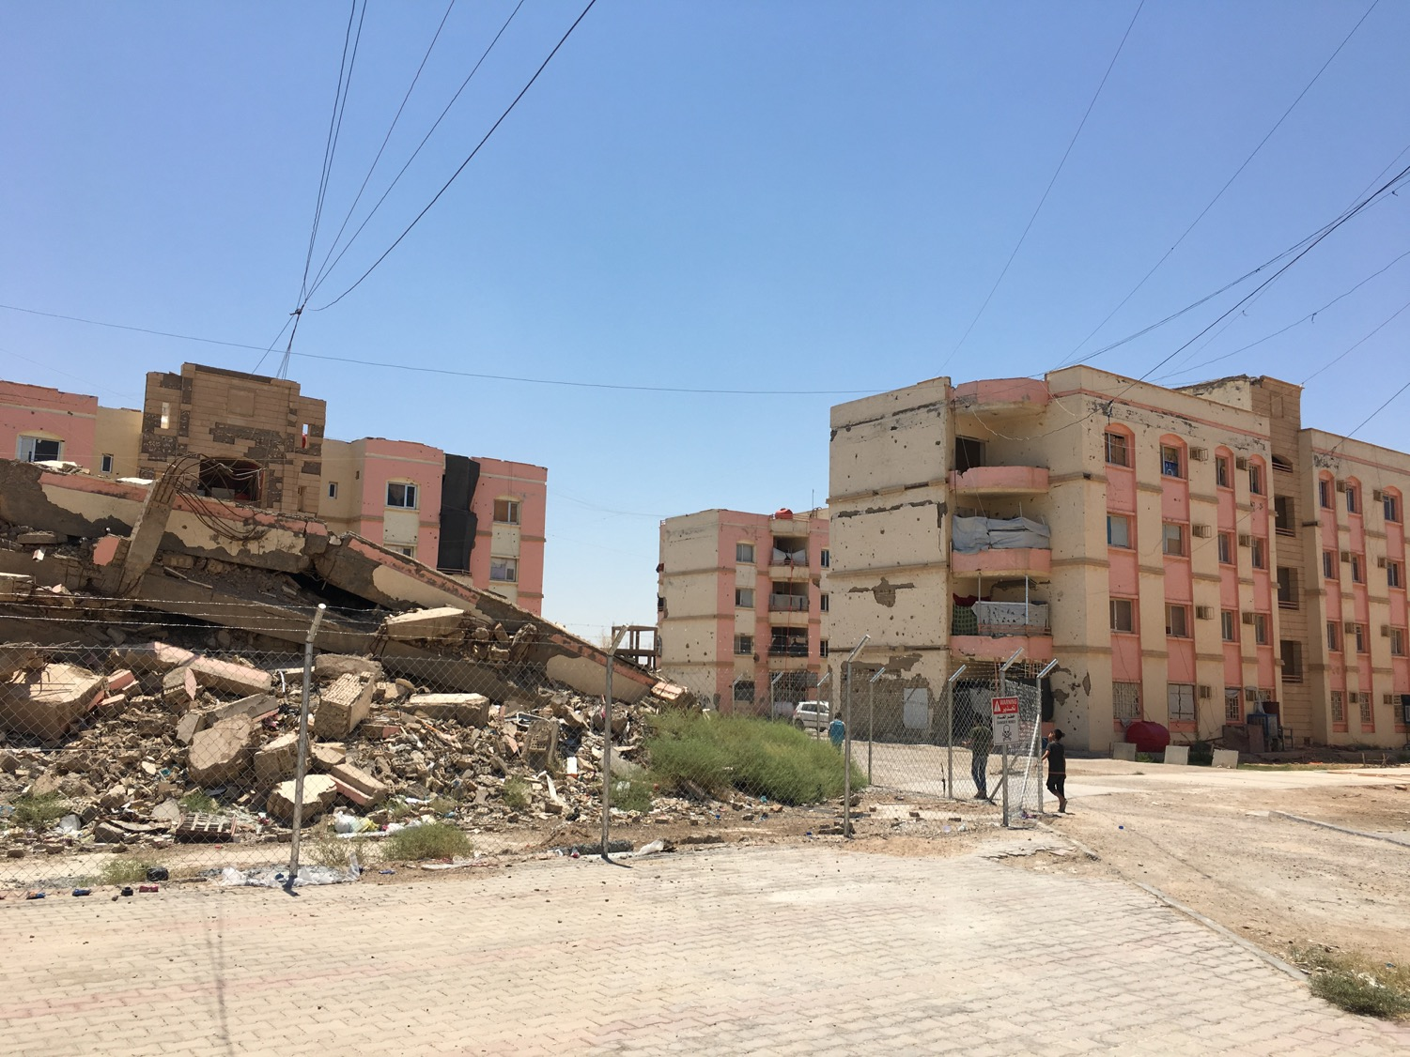
Notes:
Iraq informal settlement: “Kilo 7”

Slide 6
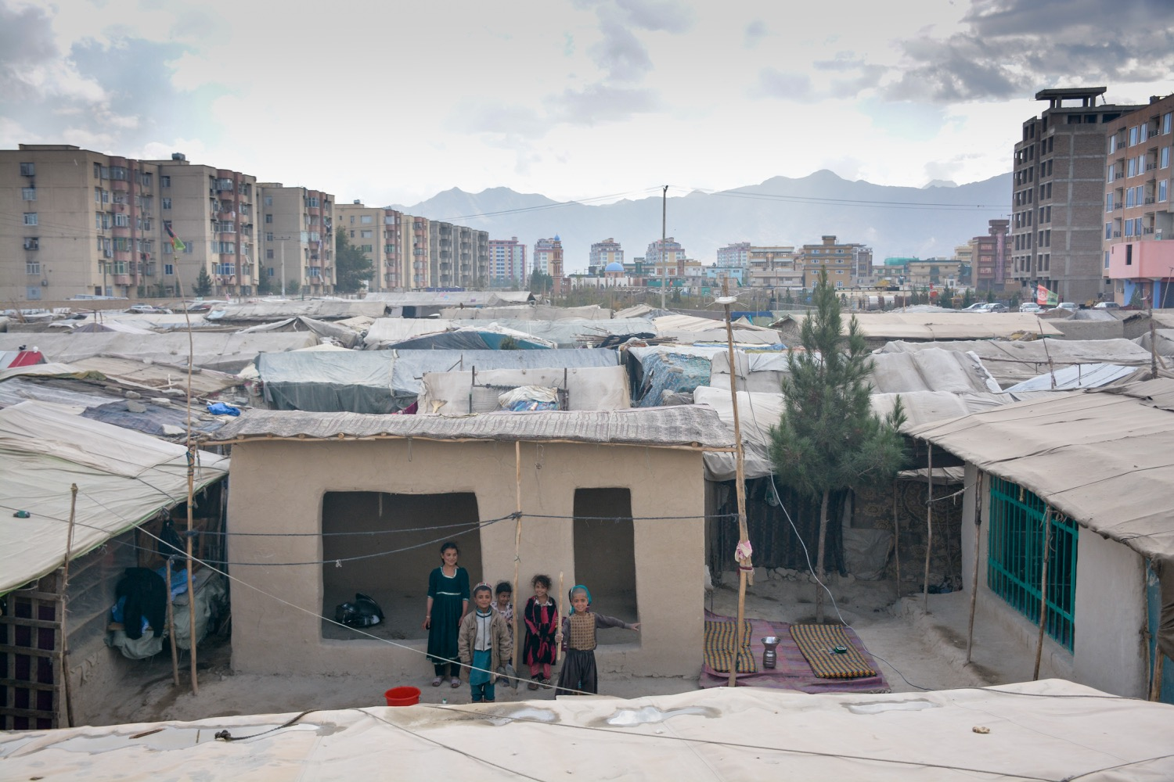
Notes:
Informal Settlement in Afghanistan, Kabul

Slide 7
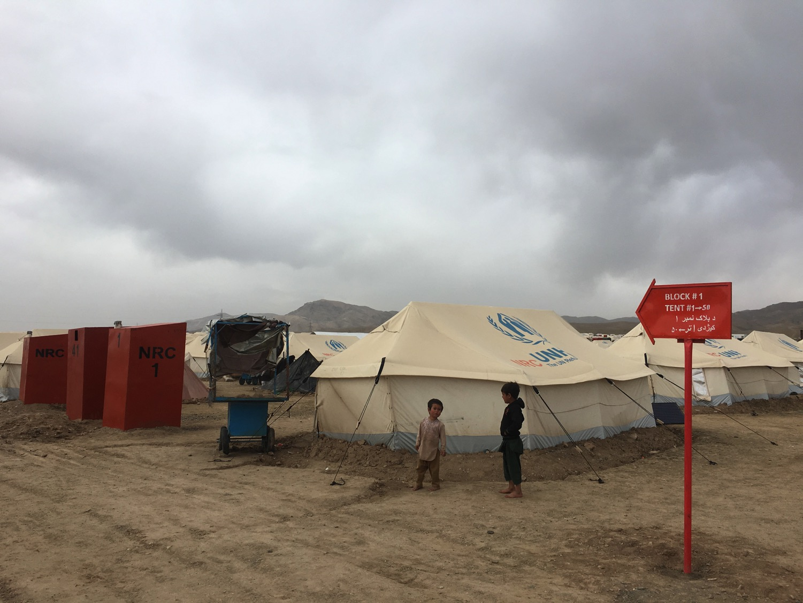
Notes:
Formal site in Afghanistan, Herat

Slide 8
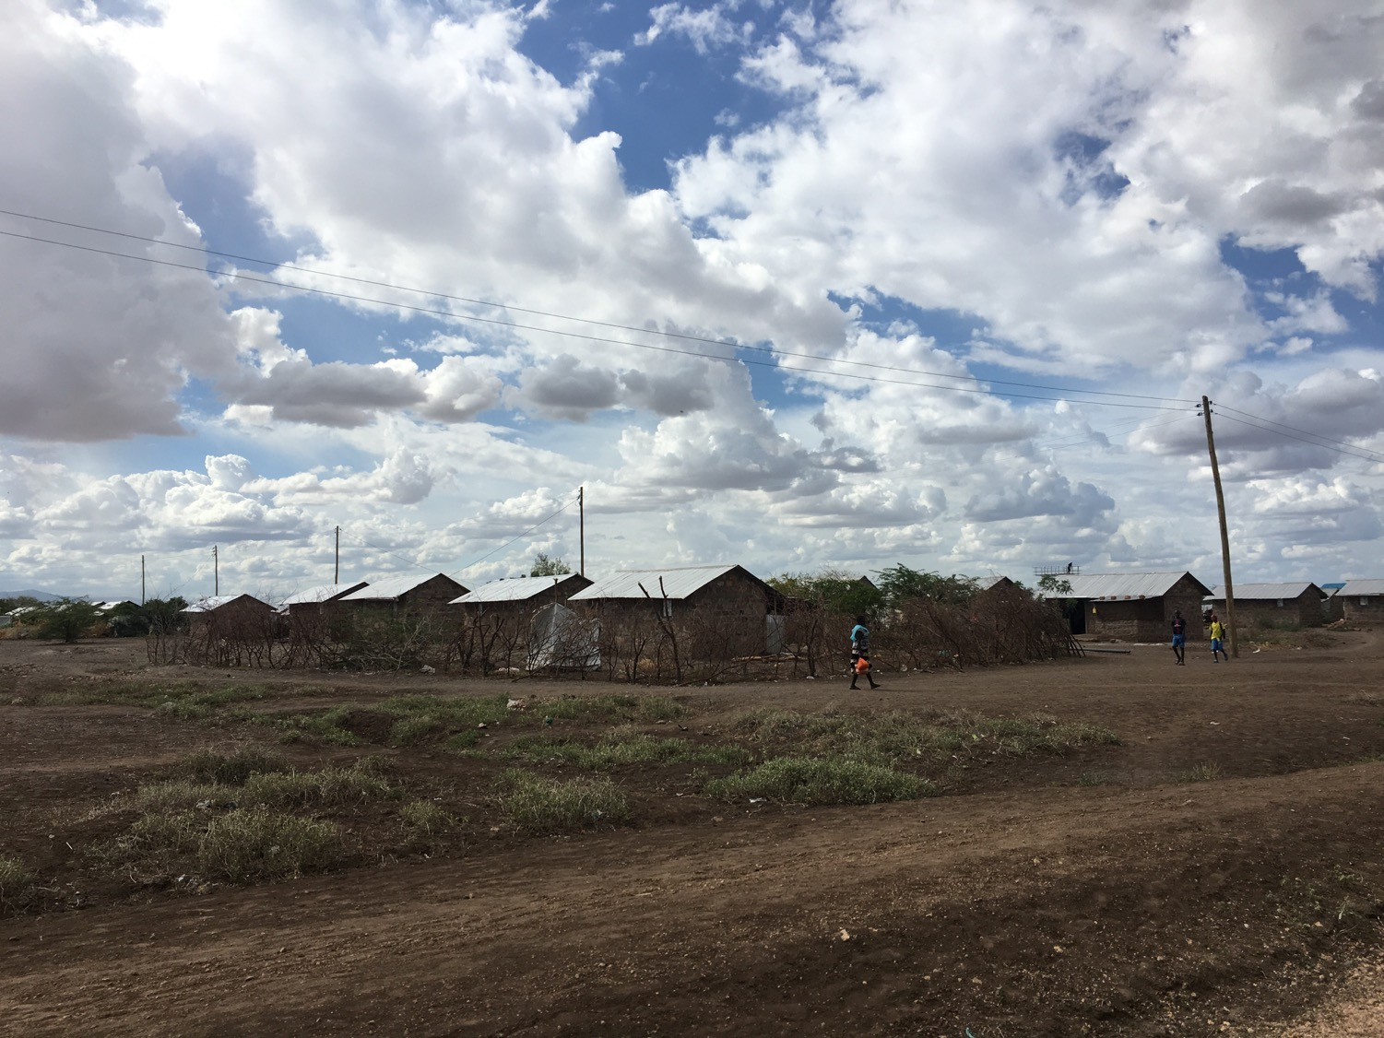
Notes:
Kalobeyei Integrated Settlement in Kenya (linked to Kakuma Refugee Camp)

Slide 9


Informants
54
152
Total:206

Slide 10





What is the relevance of this research for Camp Management?
Responsibilities of the Camp Management agency
Barriers for women’s participation
Humanitarian outcomes improved if women participate
Notes:
- Two key responsibilities of the CM agency are to support coordination and ensure meaningful participation of displaced community
- Women face barriers to participation everywhere in the world, in all spheres, and more so than men
Plenty of evidence to show that humanitarian outcomes are improved if women are able to participate
SO: this research brings together these themes to see how the CM agency can enhance women’s role in coordination in the hope of improving humanitarian outcomes, esp women’s protection and safety.

Slide 11




Definition: Participation in Coordination
Contributing to the collaborative process of information sharing and planning with a range of external stakeholders in order to identify and solve problems
Notes:
Practically this means interacting with external stakeholders through: meetings; reporting; referrals; and monitoring

Slide 12
Findings

Slide 13






What is women’s contribution to coordination?
Involved in many elements, but generally less so than men – especially meeting external stakeholders
Better understanding of household needs and more solutions-oriented than men
More aware of and responsive to issues of women’s safety and protection
Notes:
(1) More men than women attend and contribute in coordination meetings and bilateral communication with service providers; women are shy in meetings. Though women are also involved in some other elements of coordination (reporting, referrals, monitoring) they do so in an ad hoc way and are not normally provided with specific tools.
(2) Women often have a better understanding of how humanitarian assistance (or lack thereof) affects household needs, and they offer more practical and specific solutions than men – according to SPs
(3) Women are much more likely to be aware of and responsive to issues of women’s protection: i.e. safety issues pertaining to site layout and infrastructure, and GBV issues

Slide 14
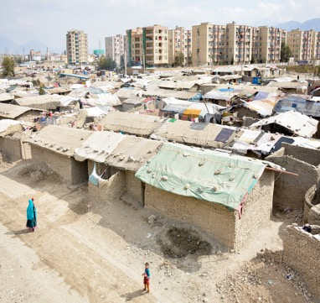
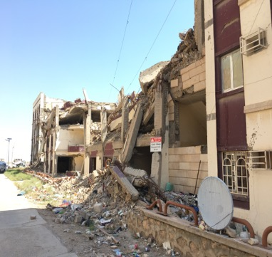
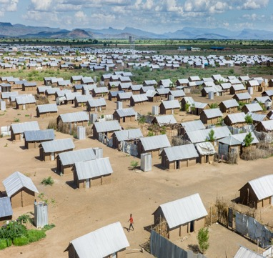
Issues addressed by women through coordination
Afghanistan
Iraq
Kenya and Tanzania

Slide 15


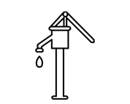

Issues addressed by women through coordination
Afghanistan
Iraq
Kenya and Tanzania
Notes:
AFGHANISTAN:
Tenure security (preventing/delaying eviction through negotiation with landlord)
Literacy classes for women (through coordination with Ministry of Education)
Digging of borewells (through coordination with NGOs)
Vocational training in tailoring (through coordination with private business/local NGO)

Slide 16




Issues addressed by women through coordination
Afghanistan
Iraq
Kenya and Tanzania
Notes:
IRAQ:
Fencing and danger signs around collapsed building with UXOs (coordination with NRC)
Fixing electrical wiring (coordination with NRC)
Monitoring municipal waste collection and identifying corruption as employees tried to take extra money from IDPs (coordination with municipality)
Introduction of PSS for children in the CFS (coordination with CFS provider)

Slide 17




Issues addressed by women through coordination
Afghanistan
Iraq
Kenya and Tanzania
Notes:
KENYA and Tanzania:
Conflict and GBV (coordination with peace committees, Camp Manager – RAS, and GBV agencies)
Empty shelters (coordination with RAS and shelter providers)
Brick harvesting sites (coordination with site planner)
Health clinic monitoring (coordination with Tanzanian Red Cross)

Slide 18

What are the barriers for women’s participation in coordination?
Notes:
The overarching barrier is a patriarchal culture. But there are subtleties in how this plays out.

Slide 19
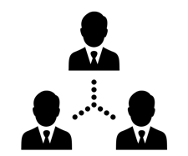


What are the barriers for women’s participation in coordination?
Notes:
CULTURE → CULTURAL EXCLUSION
Men more likely to volunteer for governance/leadership roles and more likely to attend meetings because it is assumed that they have an external liaison role
They also thereby have stronger social/professional networks than women – including those deriving from pre-crisis, and especially outside of camps/urban
Humanitarians by default talk to the men (esp out of camp) – exacerbated by predominantly male workforce.
Women also face barriers to attending meetings deriving from culture – distance, housework, childcare, permission, etc.
CULTURE → LACK OF RESOURCES AND CAPACITIES
Women are less educated than men
Women have less experience in external liaison/communication and other ‘soft’ skills compared to men.
Women lack resources such as mobile phones/credit, bicycles, etc.
LACK OF RESOURCES/CAPACITIES → STRUCTURAL EXCLUSION
Since men are more educated, they are more likely to be elected to leadership positions (many people said that they wanted to elect educated leaders)
Education level also allows men to be more effective in coordination - e.g. women’s lack of language skills (e.g. Swahili, English, Dari) mean they can’t contribute in coordination meetings; lack of literacy means they cannot write letters/petitions/lists of names.
LACK OF CAPACITY → LACK OF CONFIDENCE
Illiteracy and lack of education exacerbates lack of confidence.
CULTURE ← → LACK OF CONFIDENCE
E.g. the belief that women cannot speak in front of men. While they stay quiet, this perpetuates the cultural assumption that men do the external liaison.
LACK OF CONFIDENCE → STRUCTURAL EXCLUSION
Lack of confidence means women less likely to volunteer to attend or speak in meetings, to take leadership positions, to proactively reach out to SPs.
Their ongoing exclusion perpetuates their shyness.
Moreover, when SPs do not respond to their concerns/issues raised as leaders, their credibility and confidence is undermined.
TOGETHER: these factors combine to hinder women’s participation and effectiveness in coordination.

Slide 20

What are the barriers for women’s participation in coordination?
Structural Exclusion
Lack of Capacities and Resources
Notes:
BUT: the CM agency can address these barriers by focussing on two of them:
Exclusion from the structures and mechanisms of coordination
Capacities and resources to ensure meaningful participation (without which structural inclusion will fail)

Slide 21




How can Camp Management agencies overcome the barriers?
Support to structural inclusion
Support to development of capacities and resources
Notes:
The CM agency can turn the barriers into enablers by focussing on these two elements (structural inclusion + capacities and resources), which in turn will help to mitigate the other two barriers:
Culture – by improving women’s recognition and legitimacy in the public sphere
Confidence – by supporting their inclusion and their capacities and resources to participate

Slide 22


How can Camp Management agencies overcome the barriers?
Formalise women’s role in governance and coordination, and ensure recognition by stakeholders
Manage meetings to enable women’s participation
Facilitate access to a women’s only physical space for coordination
Develop multiple methods of coordination, including through use of digital technologies
Cultivate women’s social and professional networks
Ensure female representation in CM team
Design and implement a capacity building plan covering essential topics, as well as literacy and language (if needed)
Provide ongoing coaching and support, as well as tangible inputs for problem solving
Provide material resources to aid coordination, as well as access to livelihoods opportunities
Notes:
STRUCTURAL INCLUSION:
Legal foundation; ensuring recognition of the structure by all stakeholders; organising meetings etc. to make sure they are linked; coordination between different mechanisms
Time of day and duration; mixed (ensure balance) versus single-sex; inviting women to speak; etc.
All women appreciated Community Centres/Women Friendly Spaces, and some asked for offices → gives them legitimacy, and is a safe space to build their skills and confidence. Is also something that normally gets community acceptance/buy-in.
E.g. reports and monitoring – including through paper templates or apps
Women’s Coordination Network – see annex of main report
Female staff is critical
CAPACITIES AND RESOURCES
(7) CM should manage the plan, but may not be able to deliver all topics – work with other actors.
(8) CM should provide a ‘back stop’ to support external liaison
(9) E.g. phones and stationary, funding for community-led projects. LLHs also important as can increase confidence, independence, networks, and cultural changes. However, risks involved in providing women leaders/committee members with resources or additional opportunities if community perceives them to be personally benefiting from their role to the exclusion of other more vulnerable community members.

Slide 23


How can women’s safety be improved through their role in coordination?
Facilitate a coordinated and complementary approach between community-based protection mechanisms (e.g. protection focal points)
Arrange for women from governance structures to meet with agencies who implement services that impact on women’s safety (not only women’s protection agencies)
Ensure that gender segregated meetings take place
Train and support women to map safety risks and to present these to stakeholders; consider assigning resources for responding to issues raised
Ensure women from governance structures are trained on GBV response and prevention, including referral principles and pathways

Slide 24


anna.hirsch-holland@nrc.no
anna.hirschholland@gmail.com

