Slide 1
Agenda:
Welcome and Introduction
Mobile/area-based Case studies:
- common challenges/similarities and learnings
Next projects:
- What support would be useful for CCCM practitioners from this working group?
CCCM Retreat 2019 – ideas?
Area-based_Mobile Working Group
WG call: 25-6-19

Slide 2
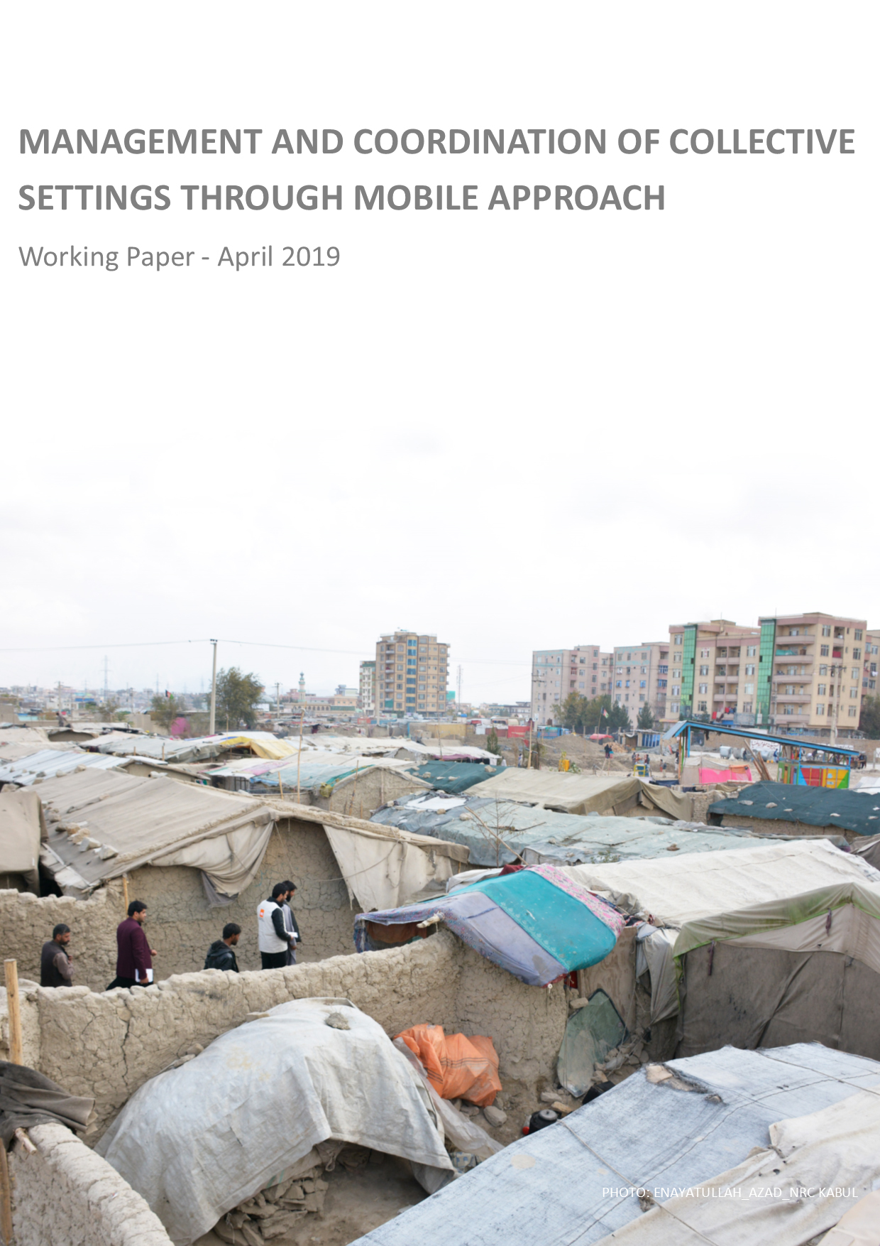
Last webinar:
Management and coordination of Collective Settings through Mobile Approach
Download link:
http://www.globalcccmcluster.org/tools-and-guidance/publications/management-and-coordination-collective-settings-through-mobile
Contact:
Giovanna Federici
ABA Working Group Chair
giovanna.federici@nrc.no
Area-based_Mobile Working Group
WG call: 25-6-19

Slide 3
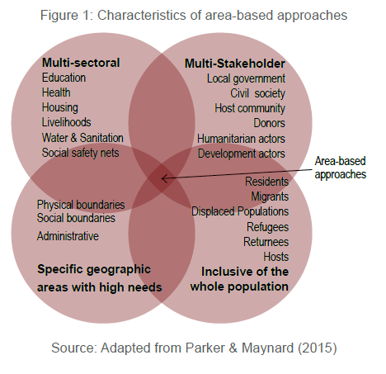
Mobile/area-based Case studies:
- common challenges/similarities and learnings
- Case studies: Iraq (mobile), Iraq (CRC), Afghanistan (Kabul/ Herat), South Sudan, Somalia
Area-based_Mobile Working Group
WG call: 25-6-19

Slide 4
Common challenges:
identification of most vulnerable and coordination of services when people live in very dispersed settlement patterns (often urban)
Working in a context of “lack of mandate”
Private landownership- restrictions on access to the site and restrictions to site/infrastructure/services/shelter improvement imposed by landlords, gatekeepers, local authorities, etc…
Eviction issues/ negative coping strategies/ HLP issues (private/ governmental land)
Over-stretched basic municipal services/infrastructure not meeting existing needs prior to influx of refugees (urban)
lack of accountability mechanisms to highlight the underperformance of service providers ( affecting all marginalized groups – displaced/non-displaced)
Ability to communicate/ influence/get response/”been taken serious” by service providers- lack of “agency” of community committees…..
Area-based_Mobile Working Group
WG call: 25-6-19

Slide 5
Common challenges:
Mobile teams- lack of constant presence- a lot more energy into service coordination and stronger commitment of other partners and service providers
Working in areas with lack of referral partners/ lack of identification of referral partners
Undermine/not able to establish trust relationships with community if no referral partners
Targeted assistance ( intermingled settlement scenario) increasing community tensions
harmonizing " assistance packages" and communication essential to mitigate tension, undermine trust relationships( within and between different community groupings)
“Soft components” ( community committees) not accepted without “Hard components” ( site improvements/Cfw) – see lack of referral/”provider of last resort”
Area-based_Mobile Working Group
WG call: 25-6-19

Slide 6
Common challenges:
Lack of understanding of outside camp CCCM approach by other sectors, partners, donors and governmental authorities.
short funding (12 month) not suitable for holistic (multi-sectorial), area-based programs
sustainable exit strategy – securing funding for continuation of CrCs, etc
Area-based_Mobile Working Group
WG call: 25-6-19

Slide 7
Common focuses/ learnings:
More time and energy is needed for (service) coordination outside of camps (more complexities)
working in (informal settlements, dispersed conditions) knowledge of HLP issues and instruments vital.
“catchment area” carefully selected on needs and presents of other services other humanitarian/NGO actors , otherwise undermines core objective of building trust with the community and sustainability.
Managing expectations of communities from the onset is vital( trust relationships)
Taking a “facilitating role” rather than a managing role ( strengthening existing structures/tools etc /less setting up new/ not direct implementation/ through community-led mechanism) to encourage ownership
Continuous close working relationship with government/ local authorities to achieve hand-over
Area-based_Mobile Working Group
WG call: 25-6-19

Slide 8
Suggestions made :
“There is a need for CCCM training that focuses on urban and informal settlement contexts. “
“The CCCM background proved important to advocate other service providers to improve their community engagement/communication with communities. “
“Harmonized assistance”/ managing expectations= trust relationships
The role of the “camp/site manager” outside of camp? “- role of site/camp manager should be emphasized even without formal mandate, as independence of community unlikely ( a fantasy)”
Area-based_Mobile Working Group
WG call: 25-6-19

Slide 9
Next projects:
- What support would be useful for CCCM practitioners from this working group?
CCCM Retreat 2019 – ideas?
Area-based_Mobile Working Group
WG call: 25-6-19

